Slide 1
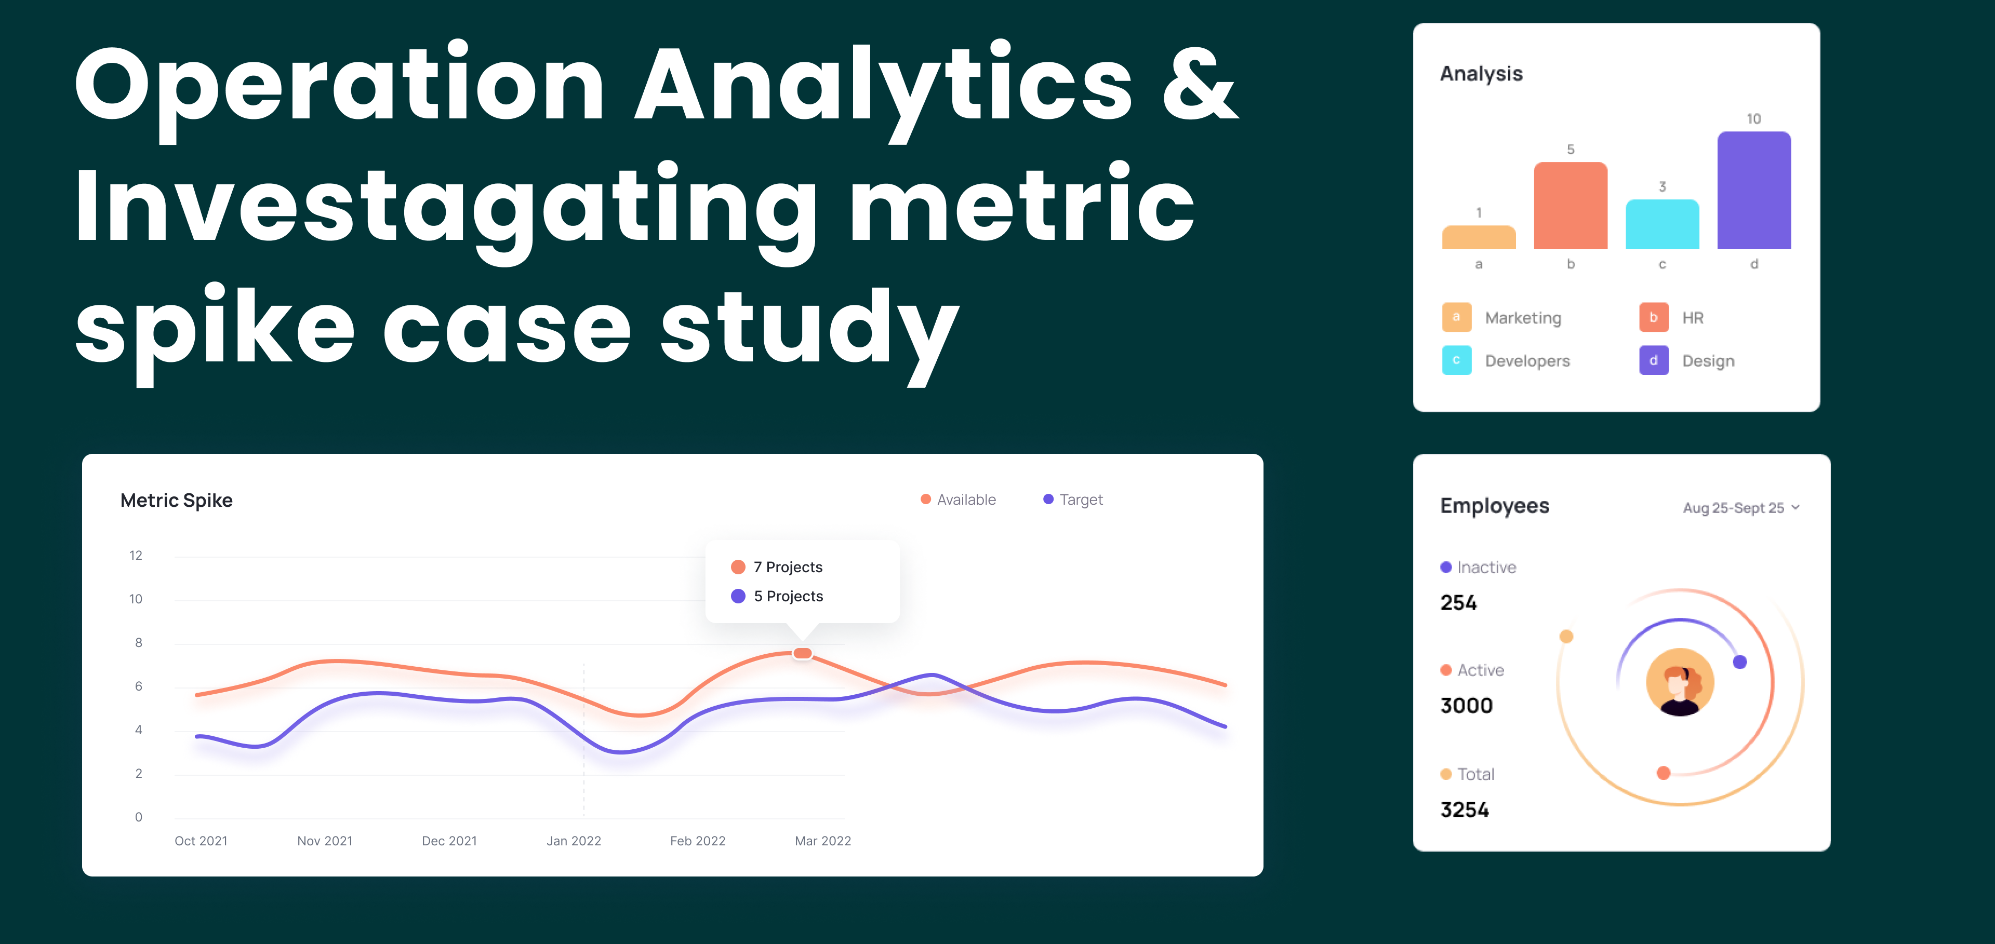
--> By Kartik Roy

Slide 2
Project Description
As a Data Analyst, I focus on analyzing extensive datasets to extract insights that optimize operations. I collaborate with teams across marketing, operations, and support to address queries and resolve data-related challenges. A key aspect of my work involves diagnosing sudden shifts in critical metrics, such as decreases in sales or user engagement.
Leveraging advanced SQL techniques, I uncover patterns and address data anomalies with precision. These insights support actionable strategies that drive informed decision-making and enhance overall company performance.

Slide 3
Approach
Understanding the data , identify key metrices, using of Adv. SQL queries for analysis, generate actionable insights and communicate findings effectively.
Using MS Excel’s dynamic feature for visualizing the generated actionable insights for the given case studys.

Slide 4
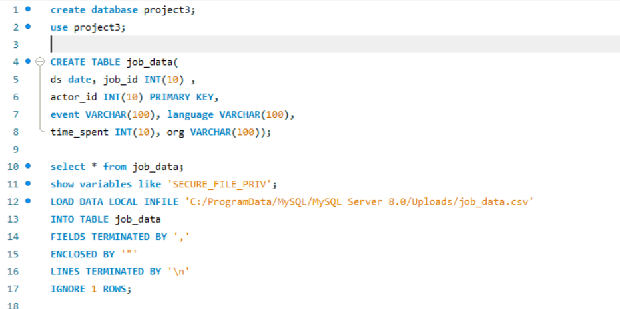
Tech-Stack Used
SQL -> For querying and analyzing the dataset.
MySQL Workbench -> Database Management tool used for executing SQL queries and visualizing results.
MS Excel
MS PPT

Slide 5
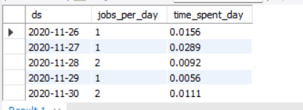
Insights
# Case Study 1 -> Job Data Analysis
# A. Jobs Reviewed Over Time:
select ds, count(job_id)
as jobs_per_day, sum(time_spent)/3600 as time_spent_dayfrom job_data
group by ds
order by ds;

Slide 6
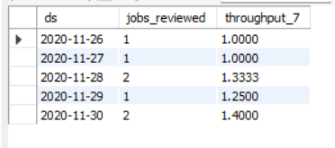
Insights
# Case Study 1 -> Job Data Analysis
# B. Throughput Analysis:
select ds, jobs_reviewed,
avg(jobs_reviewed) over (order by ds rows between 6 preceding and current row) as throughput_7 from (
select ds, count(distinct job_id) as jobs_reviewed from job_data where ds between '2020-11-01' and '2020-11-30'group by ds) as a;

Slide 7
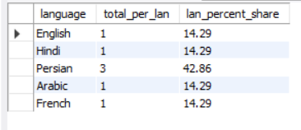
Insights
# Case Study 1 -> Job Data Analysis
# C. Language Share Analysis:
select language, p.total_per_lan, round(p.total_per_lan/t.total_lan *100,2) as lan_percent_share from(
select language, count(language) as total_per_lan
from job_data
group by language)as p,
(select count(language) as total_lan
from job_data)as t;

Slide 8
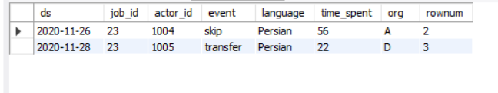
Insights
# Case Study 1 -> Job Data Analysis
# D. Duplicate Rows Detection:
select * from
(select *,row_number() over (partition by job_id) as rownum from job_data)
as a
where rownum>1;

Slide 9
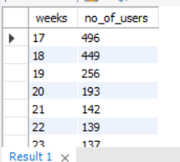
Insights
# Case Study 2 -> Investigating Metric Spike
#A. Weekly User Engagement:
select extract(week from occurred_at) as weeks, count(distinct user_id) as no_of_users
from events
where event_type="engagement“
group by weeks
order by weeks;

Slide 10
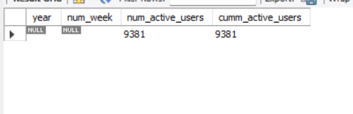
Insights
# Case Study 2 -> Investigating Metric Spike
#B. User Growth Analysis:
SELECT year, num_week, num_active_users,SUM(num_active_users) OVER (ORDER BY year, num_week ROWS BETWEEN UNBOUNDED PRECEDING AND CURRENT ROW)AS cumm_active_users FROM(
SELECT EXTRACT(YEAR FROM a.activated_at) AS year, EXTRACT(WEEK FROM a.activated_at) AS num_week, COUNT(DISTINCT user_id) AS num_active_users
FROM users a
GROUP BY year, num_week
ORDER BY year, num_week) AS B;

Slide 11
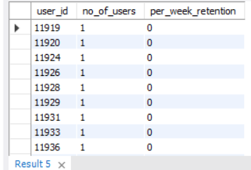
Insights
# Case Study 2 -> Investigating Metric Spike
#C. Weekly Retention Analysis:
SELECT user_id, COUNT(user_id) AS no_of_users, SUM(CASE WHEN retention_week = 1 THEN 1 ELSE 0 END) AS per_week_retention
FROM (
SELECT a.user_id, a.signup_week, b.engagement_week, DATEDIFF(b.engagement_week, a.signup_week) AS retention_week
FROM ( SELECT DISTINCT user_id, EXTRACT(WEEK FROM occurred_at) AS signup_week
FROM events
WHERE event_type = 'signup_flow' AND event_name = 'complete_signup' AND EXTRACT(WEEK FROM occurred_at) = 18 ) a LEFT JOIN ( SELECT DISTINCT user_id, EXTRACT(WEEK FROM occurred_at) AS engagement_week
FROM events
WHERE event_type = 'engagement' ) b ON a.user_id = b.user_id)
dGROUP BY user_id
ORDER BY user_id;

Slide 12
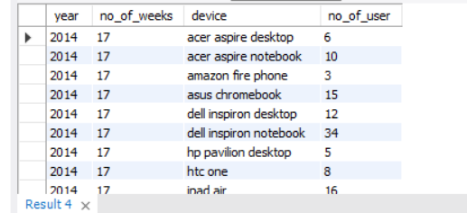
Insights
# Case Study 2 -> Investigating Metric Spike
#D. Weekly Engagement Per Device:
SELECT year(occurred_at) AS year, week(occurred_at) AS no_of_weeks,
device,
COUNT(DISTINCT user_id) AS no_of_user
FROM events
WHERE event_type = 'engagement’
GROUP BY 1, 2, 3
ORDER BY 1, 2, 3;

Slide 13
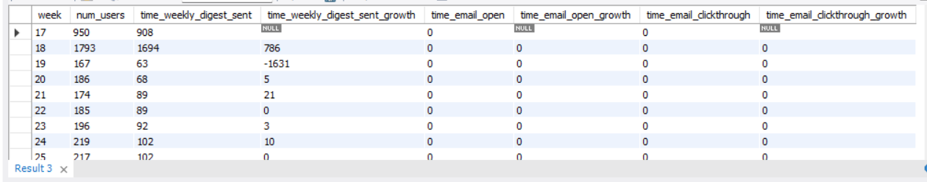
Insights
# Case Study 2 -> Investigating Metric Spike
#E. Email Engagement Analysis:
Select week,num_users,time_weekly_digest_sent,time_weekly_digest_sent-lag(time_weekly_digest_sent) over(order by week) as time_weekly_digest_sent_growth,time_email_open,time_email_open-lag(time_email_open) over(order by week) as time_email_open_growth,time_email_clickthrough,time_email_clickthrough-lag(time_email_clickthrough) over
(order by week) as time_email_clickthrough_growth From(
select week(occurred_at)as week,count(distinct user_id) as num_users, sum(if(action='sent_weekly_digest',1,0)) as time_weekly_digest_sent,sum(if(action='email_open',1,0)) as time_email_open,sum(if(action='email_clickthrough',1,0)) as time_email_clickthrough
from email_events
group by 1
order by 1) a;

Slide 14
Result
Operational analytics is pivotal in driving company performance by thoroughly examining end-to-end operations and pinpointing areas for improvement. As a Data Analyst, applying advanced SQL techniques to investigate metric fluctuations is vital for uncovering reasons behind sudden shifts in key metrics like user engagement and sales. By delivering actionable insights from data analysis, departments such as operations, support, and marketing can make well-informed decisions that streamline operations and foster business growth. This structured method not only resolves daily issues but also contributes to strategic planning and ongoing organizational development.

